Slide 1
MVC Pattern
(MVC Framework)‏
Notes:
In this session, we will learn about basic concept of MVC (Model View Controller) pattern and frameworks. Understanding MVC pattern is required in order to understand Struts and JSF later on.

Slide 2
Agenda
Introduzione al pattern MVC
Evoluzione della progettazione di architetture WEB
Model 1
Model 2
Framework applicativi
Notes:
This is the agenda. First, we will talk about general concept behind layered (or tiered) application architecture. Then we will discuss how MVC pattern fits in with this layered architecture.
During the rest of the session, we will discuss the evolution of web application design architecture starting with Model 1, then talk about Model2 and finally application frameworks.

Slide 3
Introduzione al
Pattern MVC

Slide 4
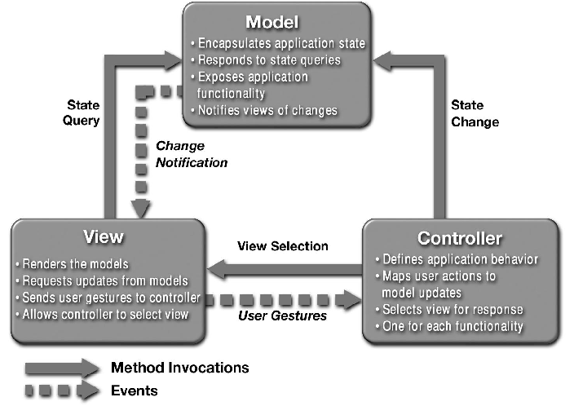
MVC Pattern
Notes:
This picture shows MVC pattern, in which Model, View, and Controller components are shown and how they interact.

Slide 5
3 livelli logici in una webapp: Model
Model: (livello Business)‏
Modella i dati ed il comportamento a livello di processo di business
Responsabile di:
Eseguire le query sul DB
Calcolare il processo di business
Processare gli ordini
Incapsula i dati ed il comportamento indipendentemente dalla loro presentazione
Notes:
So the MVC pattern is basically layered architecture for a Web application. The Model provides business process layer. It models the data and behavior behind the business process. As part of performing business process, the model layer might perform database access, calculating business process, or processing orders for example.
One important point to remember is that Model encapsulate data and behavior independent of how they are presented. That is, the presentation could change depending on the client type but the Model should not change.

Slide 6
3 livelli logici in una webapp: View
View (livello di presentazione)‏
Mostra le informazioni a secondo del tipo di client
Mostra il risultato del porcesso di business (Model)‏
Non si preoccupa di come l’informazione ed il dato è stato ottenuto nè da dove (di questo è responsabile il Model)‏
Notes:
The View represents presentation layer. The view handles displaying information according to client type. The view displays result of business logic processing, that is Model. Since View is independent of Model, the view is not concerned with how and where the information in Model was obtained.

Slide 7
3 livelli logici in una webapp: Controller
Controller (livello di controllo)‏
Funge da connessione logica tra l’interazione dell’utente ed i servizi di business nel back end
Responsabile di prendere decisioni tra diverse presentazione
Una richiesta sul layer di presentazione entra nell’applicazione tramite request il controller che deciderà come la richiesta dovrà essere gestita e quali informazioni e dati dovranno essere ritornati a valle del processo di business nel layer Model.
Notes:
(read the slide)‏

Slide 8
Web Applications
É spesso vantaggioso trattare ogni livello come una porzione indipendente della vostra applicazione
Non confondere la separazione logica delle responsabilità con l’effettiva separazione dei componenti
Alcune delle componenti possono essere combinate in un unica componente per ridurre la complessita dell’applicazione
Notes:
(read the slide)‏

Slide 9
Evoluzione della progettazione di architetture WEB
Notes:
Now let's talk about the evolution of web application design architecture.

Slide 10
Evoluzione dell’architettura MVC
No MVC
MVC Model 1 (Page-centric)‏
MVC Model 2 (Servlet-centric)‏
Web application frameworks
Struts, Spring MVC
Standard-based Web application framework
JavaServer Faces (JSR-127)‏
Notes:
Now when we talk about Web application framework, we are basically talking about the evolution of MVC architecture, which stands for Model, View, and Controller.
So in the beginning, we used no MVC. Then we had JSP Model1 and Model 2 architecture. And people came up with so called Web application frameworks such as Apache Strut based on Model 2 architecture. And finally we are at the phase there will be a standard based Web application framework.
So let's talk about these in a bit more detail.

Slide 11
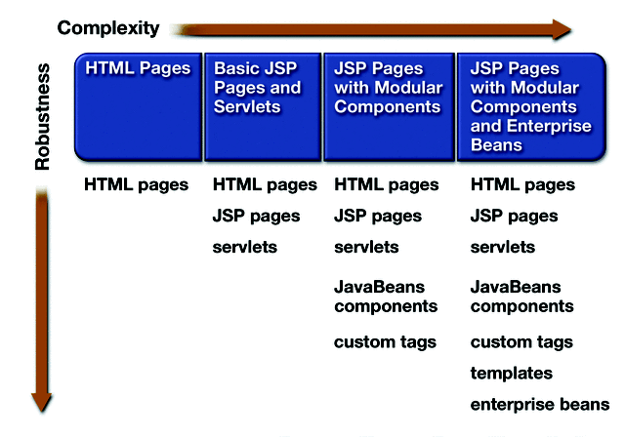
Evoluzione della progettazione di architetture WEB fino al Model 1
No MVC
Model 1 architecture
Notes:
This picture shows the evolution of web application starting from a simplest one which then evolves into more sophisticated and more robust design.
So in the first phase of the evolution, just static HTML pages were used to display static information. Then in the subsequent evolution phase, dynamic contents generation technologies such as CGI initially, then servlet and JSP are introduced to generate and display dynamic contents along with static contents.
When you are using JSP pages, you can use only the basic features that come with it. Or you can leverage more sophisticated features such as component-based dynamic contents generation, for example, leveraging JavaBeans or custom tags, which provide more reusable, more maintainable, more flexible development and deployment options.
Then in a more sophisticated environment, people use so-called template based design or eventually they might want to delegate their business logic processing to EJB tier.

Slide 12
Model 1 (Page-Centric Architecture)‏
Notes:
Let's see Model 1 architecture first. The model 1 architecture is page-centric architecture.

Slide 13
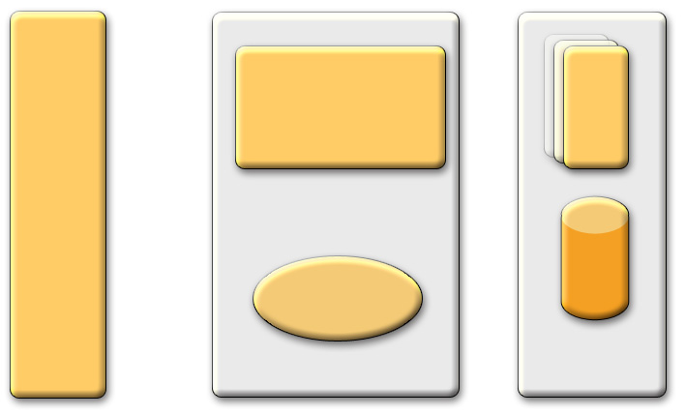
Model 1 Architecture (Page-centric)‏
1
Request
JSP
pages
4
Response
BROWSER
2
Java Bean
3
Servlet Container
Enterprise Information Systems (EIS)‏
Notes:
The literature on Web-tier technology in the J2EE platform frequently uses the terms “Model 1” and “Model 2” without explanation. This terminology stems from early drafts of the JSP specification, which described two basic usage patterns for JSP pages. While the terms have disappeared from the specification document, they remain in common use.
Model 1 and Model 2 simply refer to the absence or presence (respectively) of a controller servlet that dispatches requests from the client tier and selects views.
A Model 1 architecture consists of a Web browser directly accessing Web-tier JSP pages. The JSP pages access Web-tier JavaBeans that represent the application model. And the next view to display (JSP page, servlet, HTML page, and so on) is determined either by hyperlinks selected in the source document or by request parameters.
In a Model 1 architecture, view selection is decentralized, because the current page being displayed determines the next page to display. In addition, each JSP page or servlet processes its own inputs (parameters from GET or POST). And this is hard to maintain, for example, if you have to change the view selection, then several JSP pages need to be changed.
In some Model 1 architectures, choosing the next page to display occurs in scriptlet code, but this usage is considered poor form.

Slide 14
Architettura Page-centric
Composta da una serie di pagine JSP relazionate tra loro
Le pagine JSP gestiscono tutti gli aspetti dell’applicazione:
Presentation
Controller
Model
La logica di processo di business ed i controlli decisionali sono hard-coded nelle pagine JSP
Nella forma di JavaBeans, scriptlets, expression
La prossima pagine del flusso è determinata da:
Un click utenta su di un link:
<A HERF="find.jsp>
Attraverso la sottomissione di un form:
<FORM ACTION="search.jsp">
Notes:
In page-centric architecture, the application is composed of a series of interrelated JSP pages. And these JSP pages handle all aspects of application including presentation, and control and the business process.
Now an issue is that, in page centric architecture, the business process logic and control decisions are hard-coded inside JSP pages in the form of JavaBeans, scriptlets and expressions. Here JSP is performing the role of model.
Also in page-centric architecture, the page selection is determined inside JSP pages either user clicking on a hyperlink or action forms. Here JSP pages are playing the role of view selection which is typically handled by controller.

Slide 15
Architettura Page-centric
Notes:
This picture shows what I mentioned in the previous slide. In page-centric architecture, the next page selection is determined by each JSP page. So the page selection is distributed. (On the other hand, servlet-centric approach, which we will learn later, the page selection will be handled by a single servlet which is a centralized approach in terms of page selection.) The same thing can be said about input handling. Here each page has to handle input handling such as translation or transformation. So controller function is also distributed among different pages.

Slide 16
Scenario Page-centric
Notes:
In page centric scenario, the role of controller is played by JSP pages.

Slide 17
Model 2 (Servlet-Centric Architecture)‏
Notes:
Now let's talk about model 2 architecture which we call servlet-centric architecture.

Slide 18
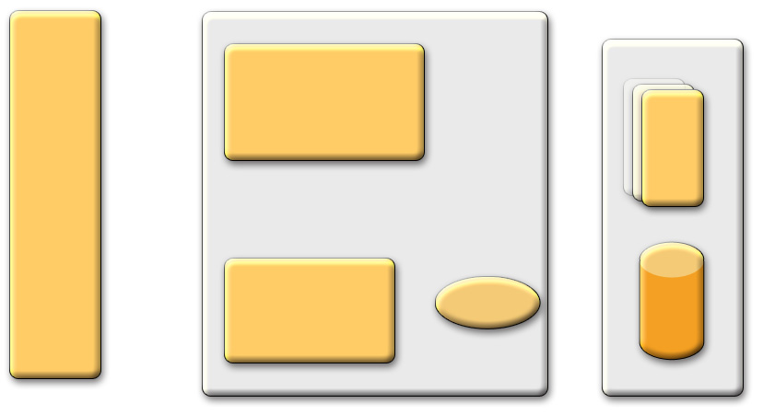
Model 2 Architecture (Servlet-centric)‏
MVC Design Pattern
1
Request
(Controller) Servlet
BROWSER
Redirect
3
2
Instantiate
5
(View) JSP
(Model) Java Bean
Response
4
Servlet Container
(EIS)‏
Notes:
A Model 2 architecture introduces a controller servlet between the browser and the JSP pages.
The controller centralizes the logic for dispatching requests to the next view based on the request URL, input parameters, and application state. The controller also handles view selection, which de-couples JSP pages and servlets from one another.
Model 2 applications are easier to maintain and extend, because views do not refer to each other directly. The Model 2 controller servlet provides a single point of control for security and logging, and often encapsulates incoming data into a form usable by the back-end MVC model.
For these reasons, the Model 2 architecture is recommended for most web applications.

Slide 19
Perchè questa evoluzione al Model 2?
Come fare se si desidera presentare diverse JSP a seconda dei dati ricevuti?
La tecnologia JSP da sola o anche combinata con JavaBeans e custom tag (Model 1) non è in grado di gestire questa situazione al meglio
Soluzione
Utilizzo di Servlet e JSP insieme (Model 2)‏
Le Servlet gestiscono la richiesta iniziale, processa parzialmetne i dati, imposta i beans ed infine inoltra I risultati ad una o più JSP
Notes:
I mentioned in previous slide, under Model 1 architecture, a view selection is done by each JSP page. And this poses a maintenance problem.
Now there is another limitation of using Model 1 architecture. In many cases, you want to select JSP pages depending on the data you received from the client. This means there has to be some software entity that handles the processing of the data and then selection of the view. And JSP is not really a good place that you can put this programming logic.
So what is the solution? Model 2 architecture. In Model 2 architecture, both servlet and JSP are used together. In other words, Servlet handles initial request, partially process the data, then forward the results to different JSP pages.

Slide 20
Architettura Servlet-centric
Le pagine JSP sono usate solo per la presentazione
Logica di controllo ed applicativa gestita e realizzata da una o più servlet
Le Servlet lavorano come un portinaio
Forniscono i servizi comuni come autenticazione, autorizzazione, login, gestione degli errori, etc…
La Servlet funge da controller centralizzato
Si comporta come una macchina a stati e/o come un dispatcher di eventi per decidere la logica appropriata per gestire la richiesta
Esegue il redirecting
Notes:
In servlet-centric architecture, JSP pages are used only for presentation and control and business process are handled by a servlet or a set of servlets.
So here, this servlet serves as a gatekeeper providing common services such as authentication, logging, translation, and transformation for all incoming requests.
This servlet also serves as a central controller acting as a state machine or event dispatcher to decide upon appropriate logic to handle the request. It also performs the redirecting the request.

Slide 21
Scenario Servlet-centric
Notes:
This picture shows servlet-centric scenario. Here the role of controller is played by a single (or a set of) servlets.

Slide 22
Web Application Frameworks

Slide 23
Web Application Frameworks
Basati su architettura MVC Model 2
Le applicazioni Web-tier condividono un insieme comune di funzionalità:
Dispacciamento delle richieste HTTP
Invocazione dei metodi del Model
Selezionare ed assemblare le views
Forniscono classi ed interfacce che possono essere utilizzate ed estese dagli sviluppatori
Notes:
Now as people are gaining more experience, they found that most Model 2 architecture based web applications share a common set of functionality. For example, they all do receive and dispatch HTTP requests, invoking model methods, selecting and assembling views.
Well, if everybody is doing the same thing over and over every time they write Model 2 based application, then people thought why don't we create a common framework that support these set of functionality so only thing you have to do is basically using or extending the frameworks using common interface and classes.

Slide 24
Perchè tali Framework?
Disaccoppiare il livello di presentazione e la logica di business in componenti separate
Fornire un punto centrale di controllo e gestione
Fornire un insieme ricco di funzionalità
Facilitare lo unit-testing e la manutenzione
Disponibilità di diversi strumenti di sviluppo
Fornire stabilità
Community-supports
Semplificare l’internazionalizzazione
Semplificare la validazione degli input
Notes:
In a more concrete terms, these are the benefits of using a common Web application frameworks. Framework decouples presentation tier from business logic, which would be useful for maintenance and reusability of the code. It provides a central point of control. Popular frameworks also come with other extra features

Slide 25
Perchè tali Framework?
I framework si sono evoluti con la tecnologia J2EE
JSP/Servlets sono complesse da usare
I Frameworks definiscono componenti riusabili per rendere questo compito più semplice.
Un buon framework definisce come le componenti lavorano per creare un’applicazione usabile
Notes:
(read the slide)‏

Slide 26
I Framework
Apache Struts
JavaServer Faces (JSR-127)‏
Spring MVC
Notes:
Now one of the most popular Web application framework is Apache Struts. Sun ONE Application framework has also popular.
Now Java community is almost done with JavaServer Faces (JSR-127) and this will unify all existing web application frameworks such as Struts and Sun ONE application framework into a single standard web application framework.

